Slide 1
Recent Advances in Animal Genetics - Genome Editing
Yalda Zare, PhD
8/29/2016
Invited talk @ Animal Breeding and Genetics Center of Iran- karaj

Slide 2
Outline
The challenge
Genome editing basics
Examples in livestock
Genome editing for quantitative traits
Application issues
The future

Slide 3
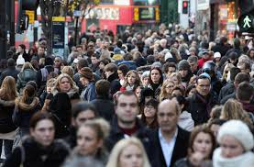
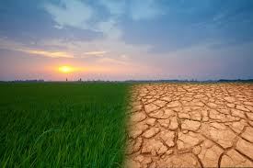
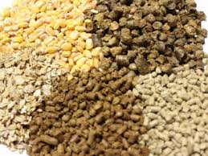
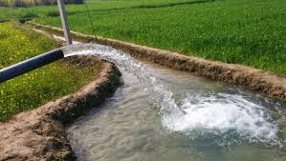
The challenge
10 billion people by 2050
70% increase in food production
Climate change
Shortage of resources
Notes:
World’s population is predicted to reach 10 billion people by 2050
With shortage of resources, climate change and increased demand of nutrition we can’t feed the world with the current agricultural systems
New methods of increasing the production of agricultural products, crops and animals with minimal impact on environment is essential

Slide 4
Advances in Animal Breeding
Advances in genotyping and sequencing technologies
Development and application of genomic selection (the most important breakthrough since BLUP in 1940s)
Notes:
Genomic evaluation has dramatically changed dairy cattle breeding
Rate of gain has increased primarily because of large reduction in generation interval
Genomic research is ongoing
Detect causative genetic variants
Find more haplotypes that affect fertility
Improve accuracy

Slide 5
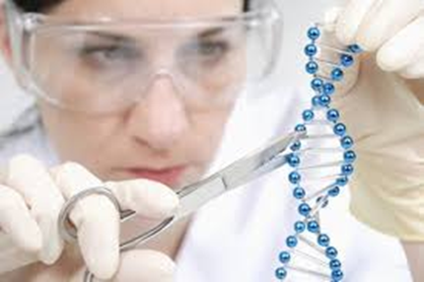
We need new methods of increasing agricultural products, crops and animals with minimal impact on environment
The idea of editing genomes has been around since 1970s. Last few years, several important advances in editing techniques

Slide 6
Transgenesis vs. genome editing
Transgenesis: The process of introducing an exogenous gene—called a transgene—into a living organism so that the organism will exhibit a new property and transmit that property to its offspring.
Genome editing: is a type of genetic engineering in which DNA is inserted, deleted or replaced in the genome of an organism using engineered nucleases, or "molecular scissors."
Notes:
A transgenic animal is one whose genome has been changed to carry genes from other species.

Slide 7
Genome Editing
double strand break
Non homologous end joining
Homology dependent repair
Notes:
NHEJ is an Error prone process that re-joins the end of the DSB, often
resulting in small insertions/deletions (blue) and subsequent gene
disruption.
Homology dependent repair is a faithful process that
uses a homologous template to repair the DSB. Providing a repair
template, either as a single stranded oligonucleotide or double
stranded DNA, allows specific modifications (green) to be
introduced to the genome. Creation of simultaneous DSBs
flanking a region of the genome can result in deletion of the
intervening sequence (yellow) and repair of the DSBs by either
NHEJ or HDR. (Color figure online)

Slide 8
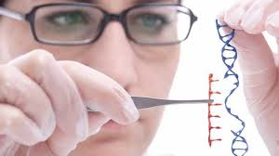
Genome editing nucleases:
ZFN (Zinc finger nucleases)
TALEN (transcription activator-like effector nucleases)
CRISPR (clustered regularly interspaced short palindromic repeats)
The difference in these techniques is the way they recognize a target location and efficiency
ZFN and TALEN use DNA-protein binding sites, (complex and costly)
CRISPR uses RNA (simpler, more popular and more efficient)

Slide 9
GE coupled with reproductive technologies
Somatic cell nuclear transfer (SCNT): has been the primary method to deliver nuclease mediated genetic changes into livestock

Slide 10
Genome editing in livestock

Slide 11
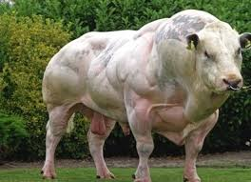
The aim was to determine the potential of genome editors as a tool for introducing desired mutations in sheep and cattle
MSTN or GDF8 is negative regulator of muscle growth
An 11bp deletion in Bovine MSTN at
position 821 results in muscular hypertrophy
(double muscle, 20% increase in muscle mass)
Mutations in MSTN result in inactivation or reduction of functional protein
Zygote injection of TALEN mRNA (OPU-IVF-ZM) used to produce gene-edited cattle and sheep
Notes:
OPU-IVF is widely used in cattle industry to rapidly produce a number of offspring (50-100) per year of a single elite cow
11 bp deletion is a frameshift mutation that results in a stop codon in four amino acids.

Slide 12
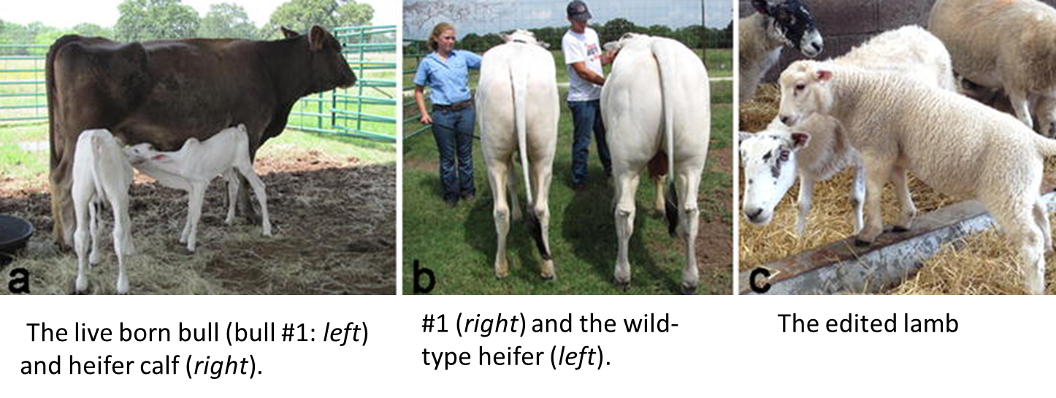
MSTN edited animals
Notes:
359 bp of bovine MSTN gene sequence showing the TALEN binding sites and the primers used to amplify the region

Slide 13
MSTN editing events
Notes:
A total of 3 unique alleles in bull #1
A second observed allele R283 was observed twice
This study showed that TALENS can be used to engineer the genome of livestock

Slide 14
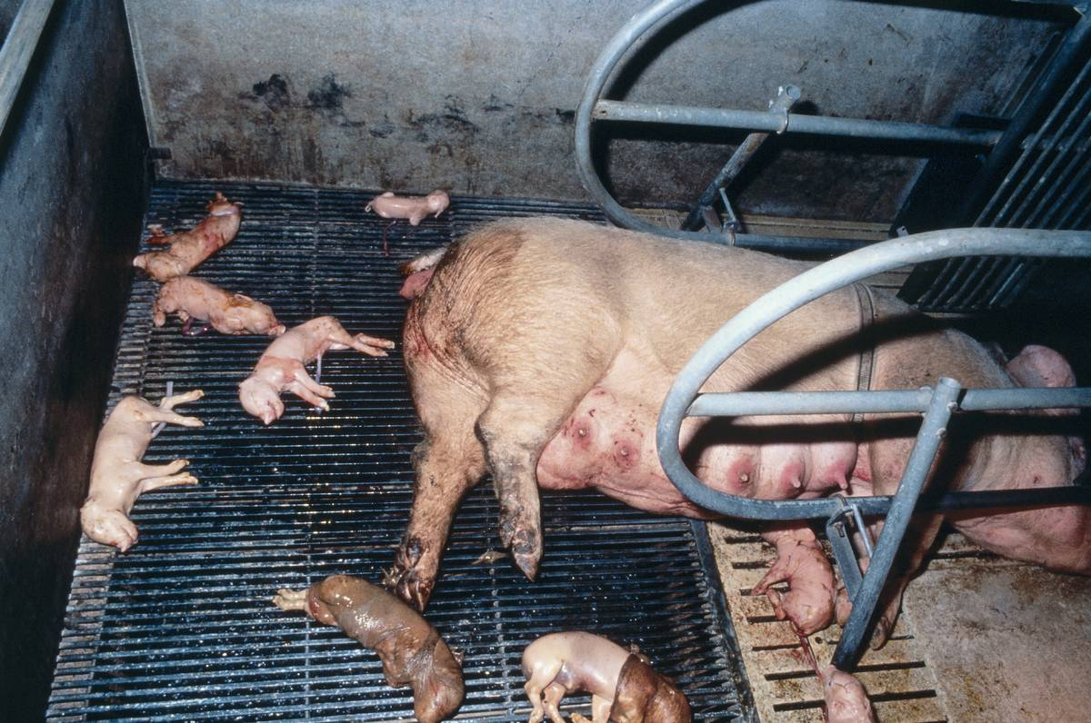

Gene-edited Porcine
Porcine reproductive and respiratory syndrome (PRRS) the most economically important disease of swine ($600 M per year in North America)
CD163 suggested as receptor for entry of PRRSV into cells.
Pigs lacking functional CD163 (edited using CRISPR-cas9) are resistant to PRRSV.
Whitworth et al,
nature biotechnology 2016

Slide 15
Notes:
7 wildtype and 3 null piglets
% of piglets with Respiratory signs at various days after the challenge
Cd163-/- displayed no signs of resoiratory or fever
Viremia (viral RNA) appeared at day 4 reached to peak at day 11 then declined
Viral RNA was not detected in null type
The antibody response was measured weakly to day 28, plateau on day 14 in positive type
No response in the null type at any point of study

Slide 16
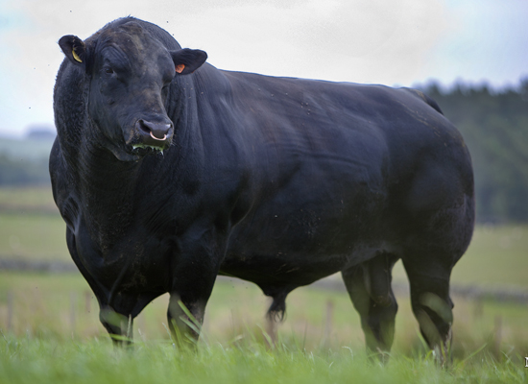
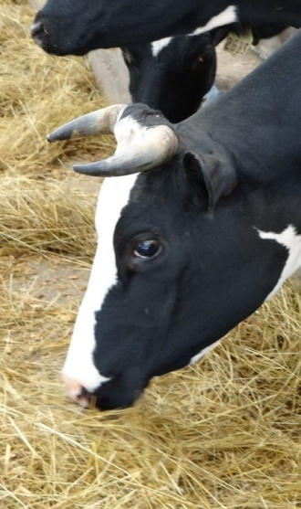
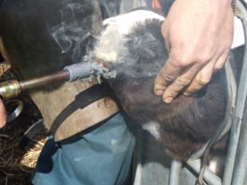
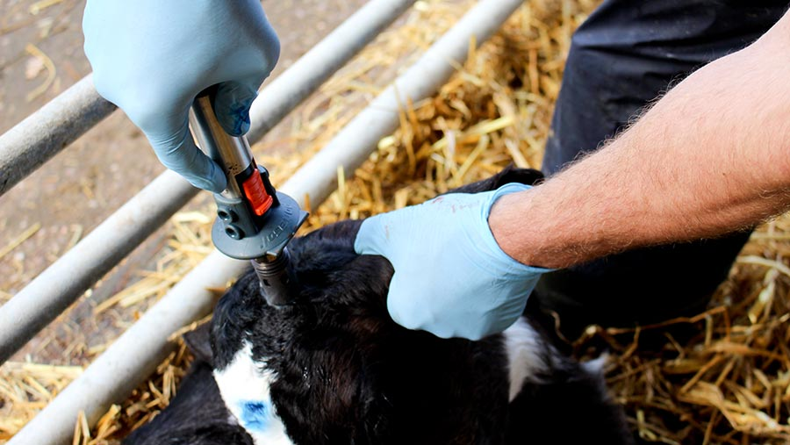
Polled Cattle
Polled livestock have been around for ages (in beef breeds).
The polled gene is rare in dairy breeds.
Dehorning is a painful process.

Slide 17
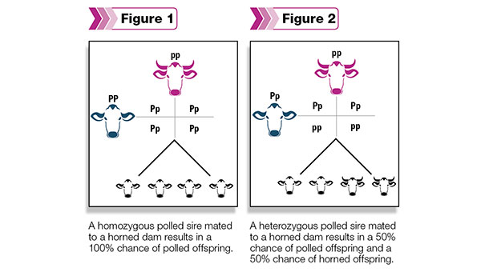
Breeding for Polled gene
Use of polled Holstein sires in classic breeding will take > 20 years to reach a frequency of 50% polled animals.
Lower EBVs for milk production: Economic loss of $252 per lactation cycle between horned and polled animals.

Slide 18
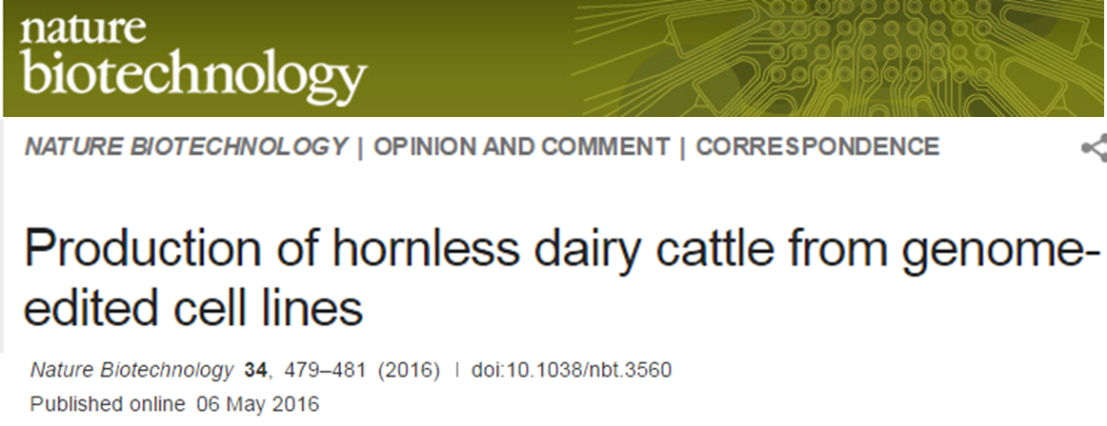
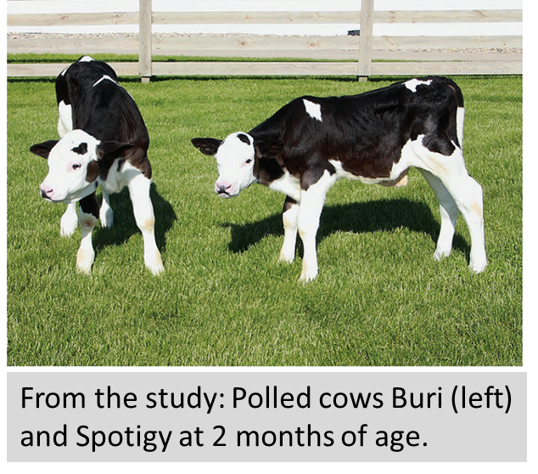
Notes:
Sequence analysis confirmed no off target effects
The traditional practice of forcibly removing forms is considered inhumane by many consumers.
Gene-editing does not introduce any gene sequences into lines of horned cattle that are not already present (and thus consumed) in naturally polled cattle.
gene-editing is “footprint free” and leaves no trace of residual gene sequence in the animal that would indicate it was the product of gene-editing

Slide 19
Genome editing for quantitative traits

Slide 20
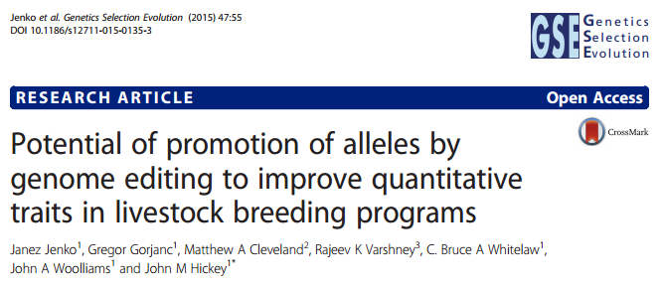
Objective: To evaluate the potential of GS supplemented by PAGE to improve quantitative traits controlled by many QTN compared to GS only

Slide 21
Why PAGE?
Increase in the frequency of favorable alleles at QTNs with conventional selection methods is slow because of many QTNs and low levels of recombination
PAGE has the potential to enable rapid increase in the frequency of favorable alleles
QTN with large effects (qualitative traits) are easier to identify than QTN with small effects (quantitative traits)

Slide 22
Simulation- genetic features
21 generations of recent historical breeding , 20 generations of future breeding
500 males and 500 females
25 sires selected, all females selected
Select sires based on TBV
GS with perfect accuracy
Traits
Polygenic with 10,000 QTN
Effects from Gaussian distribution
Selected sires were edited using different strategies

Slide 23
Editing strategies
Constrain the number of edits per selected sire
Between 0 to 100 edits
Constrain the number of edits per generation
Between 0 and 500 edits
Edit different portions of sires
All, top 5, bottom 5, top 10, bottom 10
QTN effects assumed known (big data!)
Sire edited for largest n QTN that was not already fixed for the favourable allele
Still only polygenic Gaussian effects!
GS only
GS + PAGE with restriction on the number of edited sires
GS + PAGE with restriction on the number of edits per generation

Slide 24
Comparison metrics
Response to selection
Change in allele frequency
Number of distinct QTNs edited
Inbreeding

Slide 25
Genetic gain- n edits per sire

Slide 26
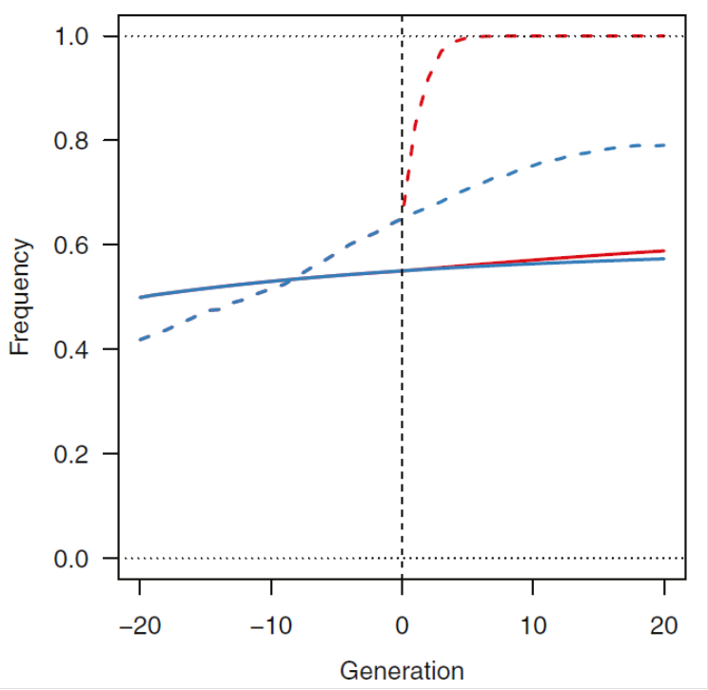
Change in allele frequency
Notes:
The average freq of favorable alleles at 20 QTN with largest effects in GS+PAGE scenario for A25Se , increased rapidly in the first 3 to 4 generations. By gen5, the average Allele freq already > 99% and full fixation by gen12
For GS only, increased linearly up to gen12 (with lower rate) and then platuead at around 0.8 after 20 gens due to hichhiking or genetic drift the favorable alleles were lost
Change in allele freq of fav alleles led to reduction of genetic variance across gens.

Slide 27
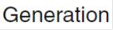
Number of distinct QTN being edited per generation
20 QTNe per sire
in all 25 sires
- Across the 20 generations, 314.6 distinct QTN edited
- These 314.6 distinct QTN explain 36% of base population genic variance
Notes:
Number of QTN in each gen and No QTN shared between pairs of gens
The No. of distinct QTN that were common decreased for pairs of distant gens
The total No of distinct QTNe in a given gen and across gens was affected by editing strategy

Slide 28
Inbreeding
Notes:
The average coef of inbreeding increased with each gen
Almost no difference in the rate of inbreeding between GS and GS+PAGE in the scenario all sires were edited
GS+PAGE scenarios in which only subset of sires were edited resulted in large increase in inbreeding
Inbreeding much higher when 5 sires were edited vs. 10 sires

Slide 29
Conclusions
GS+PAGE could increase response to selection of QTs in livestock breeding programs but QTNs must be known
Performing more edits on smaller number of sires increases response to selection but also inbreeding
PAGE enables selection of favourable alleles at QTN independent from haplotypes, chromosomes and individuals (overcome low recombination rate)

Slide 30
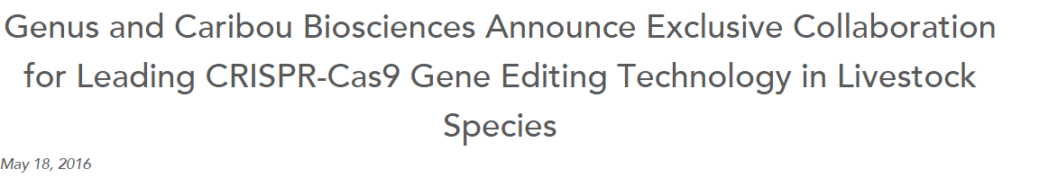


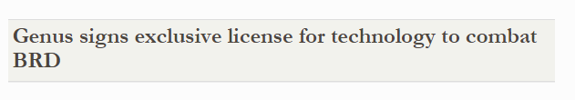

July 28, 2016

Slide 31
Application issues
Regulations and policies
Social acceptance
Health effects
Environmental effects
Moral concerns
Social effects

Slide 32
Take home message
Enhanced ability to modify genomes could be utilized to improve disease resistance, productivity, breeding capability and generation of new biomedical models
Genome-edited livestock differ from GM animals as no recombinant DNA is integrated into the animal genome.
The advent of this technology is extremely timely
The regulatory issues must be resolved first

Slide 33
The Future
Precision cross breeding
Resolving bad moves
Resolve antagonistic alleles
Traits/alleles hard to select for
Break LD
Novel alleles

